Slide 1
CELEBRATING THE ENJOYMENT OF SAUVIGNON BLANC WITH FOOD
TIM HANNI MW
tim@timhanni.com

Slide 2
Background Check
Loving and studying wine for 53 years
Professionally trained chef
Passion for French gastronomy, wine, history and traditions
That MW thing – a funny thing happened
Researching perception sciences and revising what I though I new about wine & food for over 30 years
Wine business education and creating online wine business calculators and workbooks a big part of my company…
WWW.WINEBUSINESSEDUCATION.COM

Slide 3
A Bi#tch-slap for Wine Geeks
There is no such thing as a perfect pairing or immutable wine pairing truth.
There is no such thing as a perfect wine.
What wine ‘goes with unicorn’ – might as well search for that while you are at it.
People take wine descriptions personally – if you continue to talk about entry level, novice, unsophisticated and or/ commercial wines people will stop drinking the. STOP IT!
Arrogance should be left for arrogant people, not embraced by the industry.

Slide 4
Nothing in the world
is more dangerous than
sincere ignorance and
conscientious stupidity.
Martin Luther King, Jr.

Slide 5
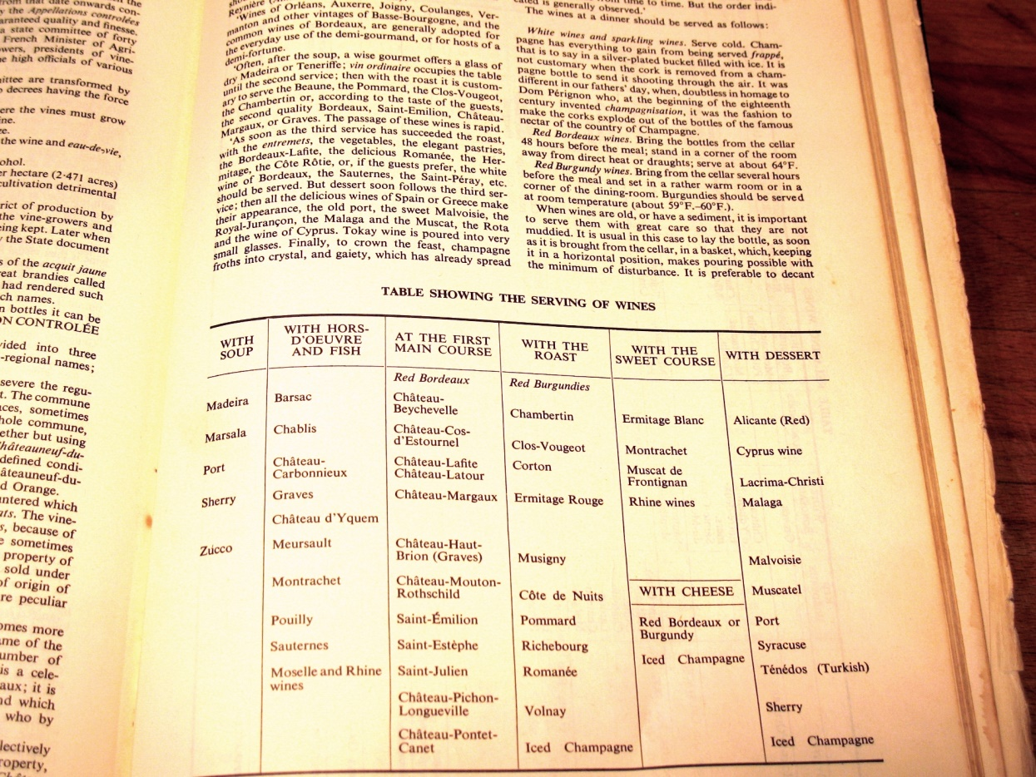
The Genesis of the BS

Slide 6
Takeaway for this Session

Slide 7
Position Statement
Wine & Food “pairing” or “matching” was never a tradition in France until recently.
The emergence of Wine & Food pairing coincides with PLUMMETING consumption in France (and Italy).
Biological sensory individualism (genetic/physiological differences) alone provides a basis for revising how we approach enjoying NZSB with wine.
We need to educate the wine trade, hospitality professionals and wine influencers (and not necessarily consumers) to better serve the personal interests of wine lovers.
THIS IS A WIN-WIN SITUATION FOR EVERYONE EXCEPT THOSE UNWILLING TO CONSIDER POSITIVE DISRUTION AND CHANGE!

Slide 8
Decline of Consumption Over 80%

Slide 9
A Couple of Warmup Questions
Anyone here like New Zealand Sauvignon Blanc?
Are there many styles of Sauvignon Blanc?
Do you have personal preferences for certain styles of New Zealand Sauvignon Blanc?
Do you fret (and if you don’t, do you imagine consumers do) about what food you are choosing when you decide to enjoy a New Zealand Sauvignon Blanc?
Do you want to sell more New Zealand Sauvignon Blanc?
A CASE FOR A NEW CAMPAIGN TO STOP “MATCHING” FOOD AND NEW ZEALAND SAUVIGNON BLANC

Slide 10
per·cep·tion (pərˈsepSH(ə)n) noun
the ability to taste, smell, see, hear, or touch that makes us aware of something through the senses.
"the normal limits to human perception“
2. the state of being or process of becoming aware of something through the senses.
"the perception of taste“
3. a way of regarding, understanding, or interpreting something; a mental impression.
“the wine industry’s perception of wine preferences of the American public"
synonyms: | recognition, awareness, consciousness, appreciation, realization, knowledge, grasp, understanding, comprehension, apprehension; formalcognizance "our perception of our own limitations"

Slide 11
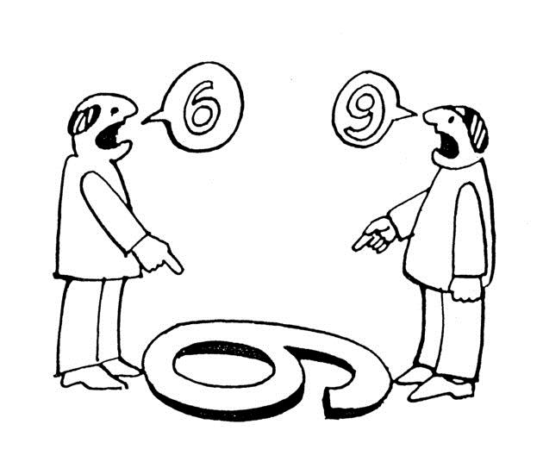
Who is right??

Slide 12
Sensations are Subject to Illusions

Slide 14
Sensory Perception Factors
Genetics and Physiology
Determine range and intensity of sensations we detect
Neurology
Cognition: awareness and discernment
Sensory interactions
Psychology
Memories and ability to retain information previously cognized stimulus
Preferences, attitudes and behaviors in response to stimulus
Identification of a sensation from previous encounters or knowledge: REcognition

Slide 15
Can We All Agree?
“We all live in different sensory worlds”
Dr. Linda Bartoshuk

Slide 16
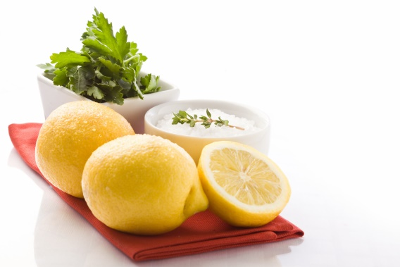
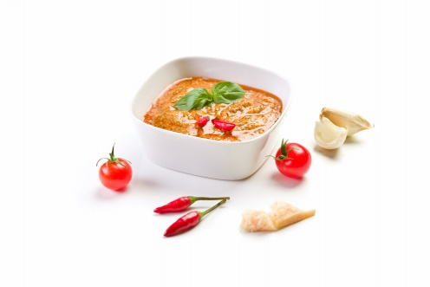
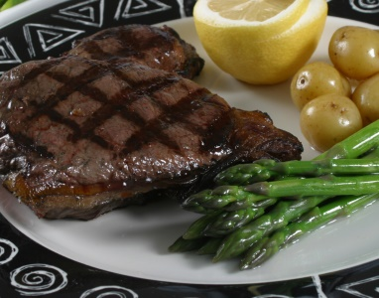
Wine & Food Interactions
Based on primary sensations:
Taste
Sweet
Sour
Salty
Bitter
Umami
Touch
Smell
Predictability to a point
Foundation for understanding “what happens”
SUBJECT TO INDIVUAL VARIABLES: PERSONAL!

Slide 17
Balanced Food is Good with Wine
MAKES WINE MILDER
Less dry (sweeter)
Fruitier
Less bitter and tannic
SALT IN FOOD
SOURNESS IN FOOD
BALANCE = DELICIOUS FOOD THAT IS GREAT WITH ANY WINE YOU LIKE
SWEETNESS IN FOOD
UMAMI IN FOOD
MAKES WINE STRONGER
Drier (less sweet)
Less fruity
More acidic
More bitter and tannic
Notes:
Speech Notes - Slide 23
1. [Slide Par: 1] page 25
page 25

Slide 18
Why YOU Like What You Like
Sensory Sensitivity
(Anatomy - how many receptors, what kind, intensity of transmission of sensations)
Learning,
Observation…
(psychology)
Culture, Peers,
Environment
(sociology)
Life
Experiences…
(memories)
PERSONAL OPINIONS
Right vs. Wrong
Good vs. Bad
Like vs. Don’t Like

Slide 19
Avoid the pretense of thinking what you smell, taste and prefer is what someone else should experience!

Slide 20
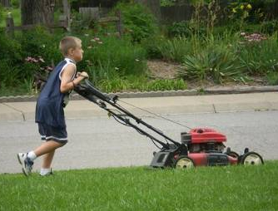
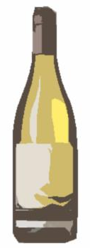
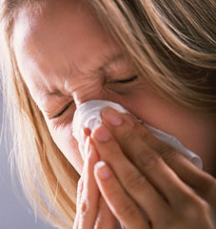
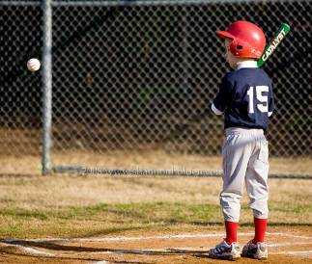
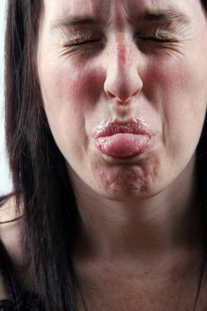
NZSB - Like, Love or Hate
Many Factors Contribute to Personal Sauvignon Blanc Preferences
New Zealand
SAUVIGNON
BLANC

Slide 21
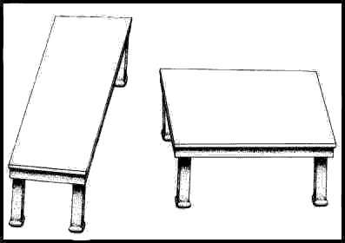

Slide 22
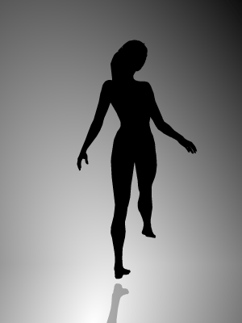

Slide 23
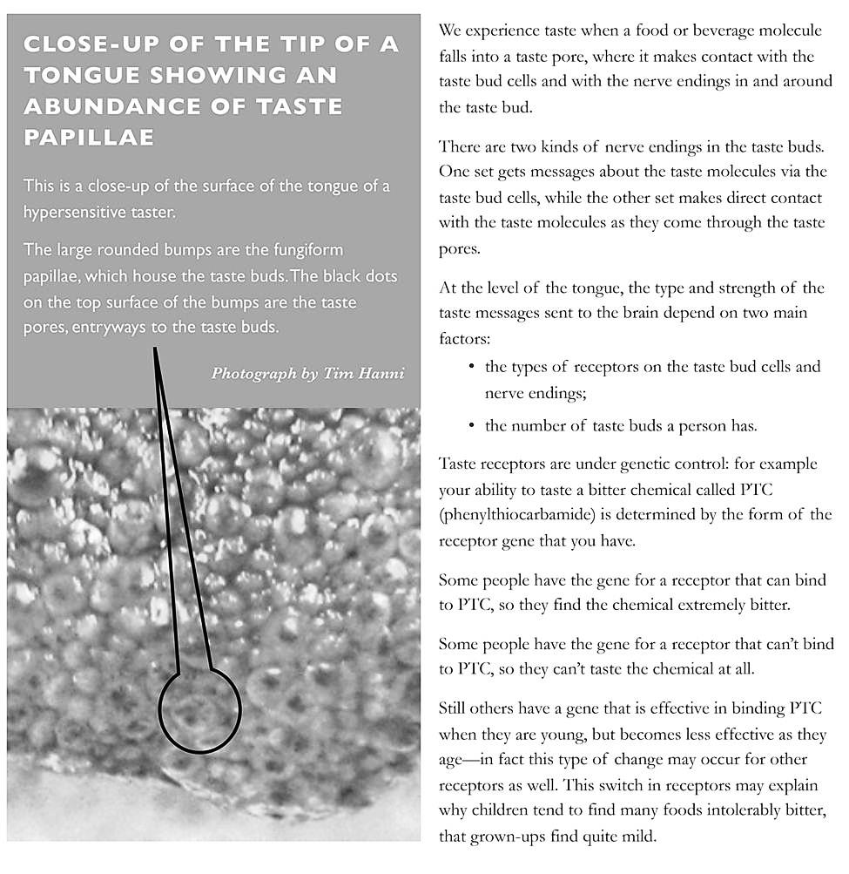
Sensory Genetics & Physiology

Slide 24
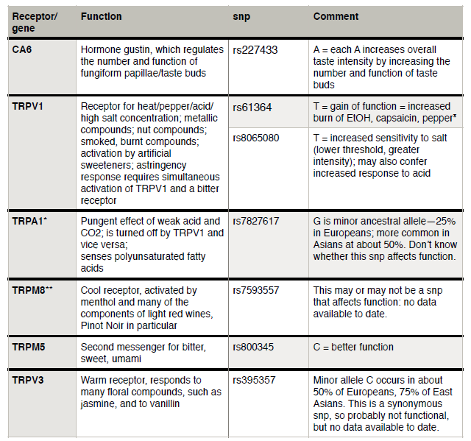
The strongest variant lies within a cluster of olfactory-receptor genes—part of the genome which influences our sense of smell. Buried within that cluster is a gene called OR6A2, which encodes a receptor that makes people sensitive to the aldehyde chemicals contributing to cilantro's characteristic flavor.

Slide 25
Revisionist History
“Challenging the orthodox (established, accepted or traditional) views held by professional scholars about a historical event, introducing contrary evidence, or reinterpreting the motivations and decisions of the people involved.”

Slide 26
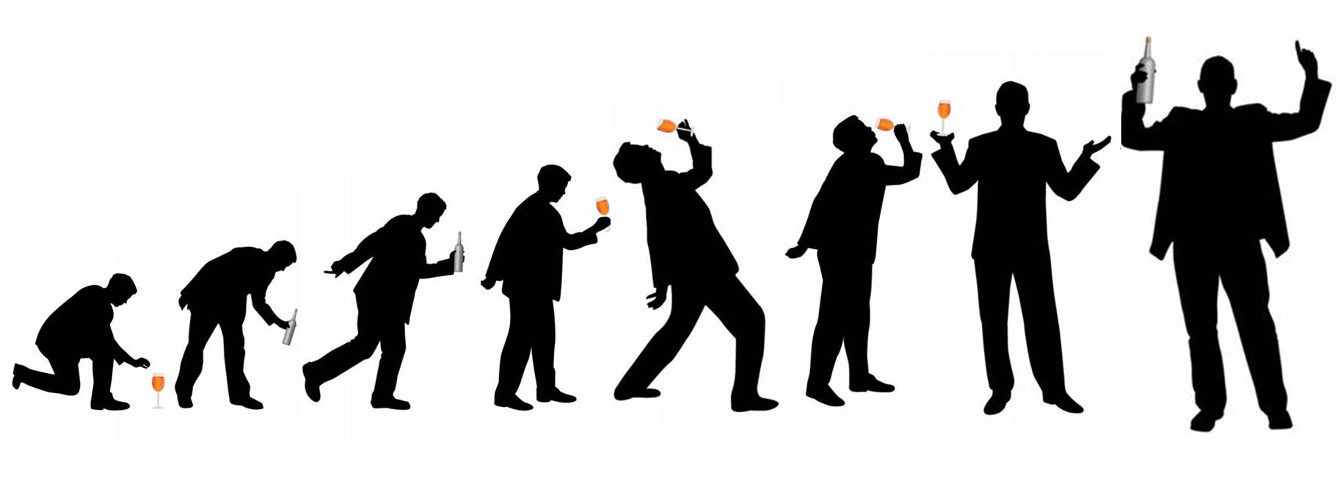
Your ‘Palate’ matures?
No, our wine preferences result from a combination of our perceptive capacities and neural programming over time…neural gastronomic programming.

Slide 27
Metaphor

Slide 28
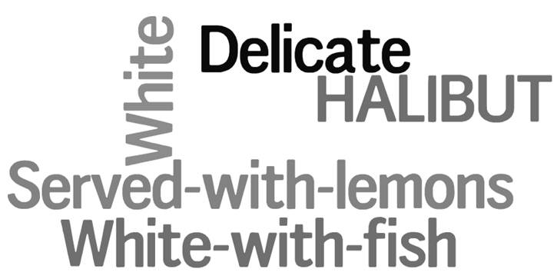
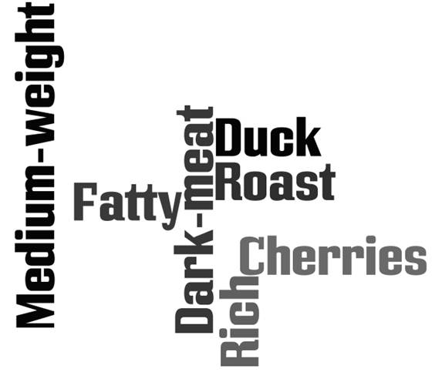
Wine & Food Metaphor Matching

Slide 29
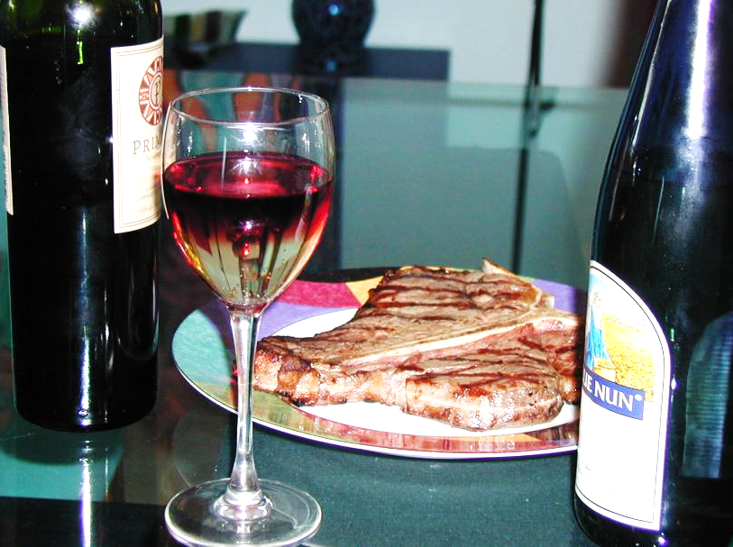

Slide 30
Wine & Food Matching Today
Metaphors
Pseudoscience
Misunderstandings
Hyperbole
Ignorance

Slide 31
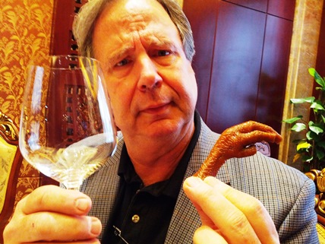
In China It is Difficult to Pair Wine & Food
No, it is not.
All the food is served at once, JUST LIKE FRENCH CUISINE!!
Service à la française (French, "service in the French style") is the practice of serving various dishes of a meal at the same time. That contrasts to service à la russe ("service in the Russian style") in which dishes are brought sequentially and served individually.

Slide 32
Wine & Food Matching Tomorrow?
Understand the factors that contribute to personal preferences
Connect with consumers at a powerful and personal level
Understand, embrace and cultivate ALL wine consumers
Guide the people who are interested in learning more about wine to do the same
SELL MORE NZ SAUVIGNON BLANC!

Slide 33
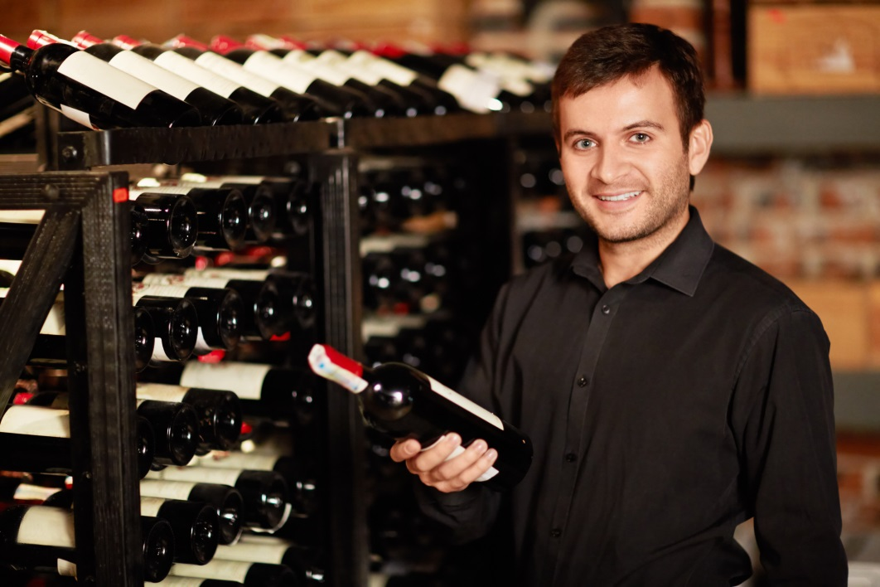
Can I help you find a wine you will love?
I am a
TRAINED WINE
PROFESSIONAL
Let me help
YOU

Slide 34
Questions? For more information: www.timhanni.com tim@timhanni.com

